Slide 1
Regularization Terms
By : L Vinay Rajiv Reddy

Slide 2
What are Regularization terms ?
Def: Regularizes the coefficient estimates towards zero.
Ridge
Lasso

Slide 3

But why regularization needed ?

Slide 4
But why regularization needed ?
As we tries to regularize,
the over fitting is controlled

Slide 5
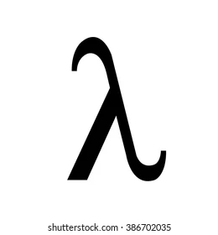
Ridge
St. Line equation : Y= mX + C
Ridge equation : Y| = [(Slope)² x ] X + C

Slide 6
Lasso
We regularize even more than ridge
Lasso Equation = [ x |slope| ] X + C
If more than 2-D :
Lasso Equation = [ x |m₁ + m₂ + ………..m_{n}| ] X + C
It also helps in feature selection too.

